Slide 1
RSA in Python
By Spencer Miller
April 14th 2022
Professor: Kaveh Shamsi

Slide 2
RSA Overview
1) Find two large prime numbers, p & q
2) Compute n = p*q
3) Find the least common multiple (LCM) of p-1 & q-1 and call it the totient. (p-1)*(q-1)
4) Select a number e between 1 and the LCM
5) Calculate the private key d. This involves finding the modulo inverse of e with respect to the totient using the extended Euclidean Algorithm.
6) Encryption
7) Decryption

Slide 3
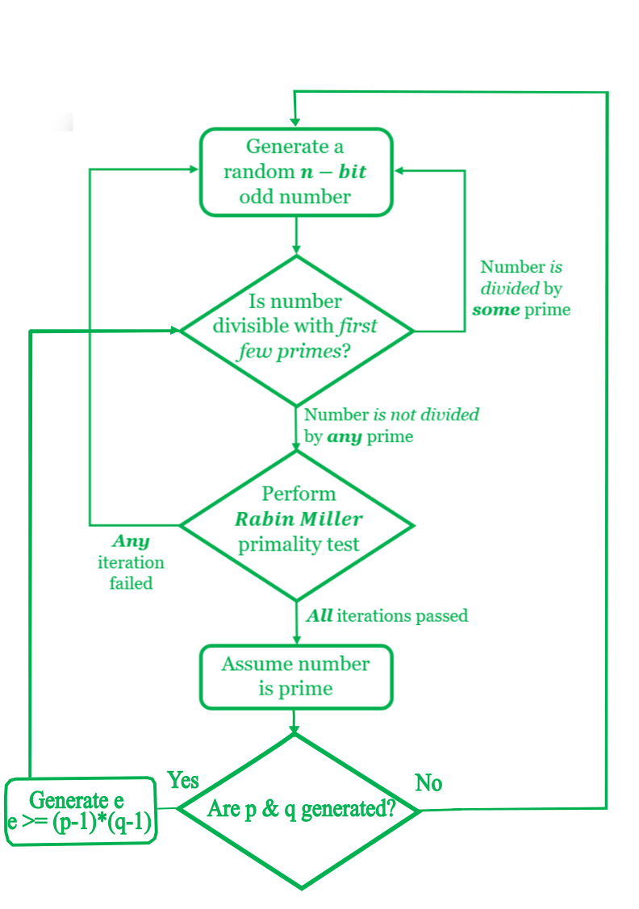

Prime Generation
The Functions
nBitRandom(n)
getLowLevelPrime(n)
isMillerRabinPassed
(miller_rabin_candidate)
4)trialComposite
(round_tester)
$2^{n−1}+1≤Random Prime Number≤2^{n}$-1
e
$$≤$$

Slide 4
Private Key Generation
The Function
1) modInverse(e, totient)
This function computes the modular inverse with respect to the totient using the Extended Euclidean Algorithm.
Time Complexity: O(log m)
Auxiliary Space: O(1)

Slide 5

Encryption
The Function
encrypt(msg, e, n)
Each digit of the message is then converted into ascii.
The ascii value is then raised to e and mod with n to output a cipher digit.

Slide 6

Decryption
The Function
decrypt(c, d, n)
Each digit of the cipher is raised to d and mod with n to output a message digit.
The ascii value of each message digit is then printed.

Slide 7
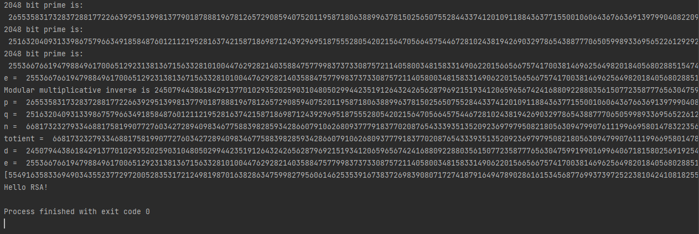
Demonstration
n = 2048
p
Prime Generation
q
e
Private Key Generation
Cipher Text
Decrypted Text

Slide 8
Live Demonstration
For the sake of runtime, let n = 100

Slide 9
Sources
[1] “How to generate Large Prime numbers for RSA Algorithm,” GeeksforGeeks, Jun. 26, 2020. https://www.geeksforgeeks.org/how-to-generate-large-prime-numbers-for-rsa-algorithm/
[2] J. Lake, “What is RSA encryption and how does it work? | Comparitech,” Comparitech, Dec. 11, 2018. https://www.comparitech.com/blog/information-security/rsa-encryption/
[3] “Programming Challenges - 5 - RSA Encryption (Python),” www.youtube.com. https://www.youtube.com/watch?v=KS169C845aU (accessed Apr. 26, 2022).
[4] Ankur, “Modular multiplicative inverse” GeeksforGeeks, Jun. 20, 2015. https://www.geeksforgeeks.org/multiplicative-inverse-under-modulo-m/
[5] “Python | Ways to convert list of ASCII value to string,” GeeksforGeeks, Jun. 27, 2019. https://www.geeksforgeeks.org/python-ways-to-convert-list-of-ascii-value-to-string/ (accessed Apr. 26, 2022).
[6]“Extended Euclidean Algorithm Calculator,” extendedeuclideanalgorithm.com. https://extendedeuclideanalgorithm.com/calculator.php?mode=2&n=362880&b=929#num (accessed Apr. 26, 2022).
‌
‌
‌
‌
‌
‌

Slide 10
Sources Continued…
‌[7] “Calculating the modular multiplicative inverse using the Extended Euclidean Algorithm,” extendedeuclideanalgorithm.com. https://extendedeuclideanalgorithm.com/multiplicative_inverse.php (accessed Apr. 26, 2022).
[8] B. Steyn, “How RSA Works With Examples,” 2012. Accessed: Apr. 26, 2022. [Online]. Available: https://www.cae.tntech.edu/~mmahmoud/teaching_files/grad/ECE6900/S21/slides/RSA.pdf
‌
‌
‌
‌
‌
‌
‌
‌

